Slide 1
Data Warehouse Granularity

Slide 2
Data Granularity
“Data granularity refers to data’s level of detail. The more granular the data, the more detailed it is and the more precise analysis can be.”(1)
As data does not always work together and thus when designing a database it is best to have a plan on how one should make the data work with other types
Three things to understand about working with Granularity
- get your data to the same level of granularity
- use the analogy of lowest common denominator
- to get to same level of granularity you need to summarize the more detailed data (ex. customer sales multiple times per day) up to the same higher level of granularity as the other table (monthly sales per store)

Slide 3
Continuous and Discrete Variable
Continuous are variables like time, measurements, and location. Variables that can go on forever.
Discrete are variables that you can’t go on forever counting.
An example of Discrete variables, like how much money someone has in their bank account. It will be a certain amount of money and never have more than two variables.
For example, there are days, then hours, then minutes, then seconds, then milliseconds, and so on for a time variable.

Slide 4
Lowest Common Denominator
Remember what the lowest common denominator means, the denominator that both of two different factions share. For example, the lowest common denominator of 1/2 and 1/4 is 4 and so you would need to change 1/2 to 2/4. Another lowest common denominator would be 1/2 and 2/3 would be 6. 3/6 and 4/6.
In the next slide, we are shown an example of having a problem with data granularity.
We want to know how much of a percentage each of the customers contributes to revenue. But one piece of data is updated monthly and another daily.
In order to solve this, we need to find the least common denominator or the least granular of the data. In this instance it is months. And so, to solve this problem we need to, for example, solve it with coding. Something like a group by and combining each day can help us have the information monthly

Slide 5
Customer % of total store sales in January 2022
Monthly store sales
Daily customer sales
Customer’s total ext amount for / store’s total ext amount
Month (YYYYMM)
Store ID
Tot Qty
Tot Ext amount
Date (YYYYMMDD)
Customer ID
Store ID
Qty
unit price
Ext amount (qty * unit price)
20220105 Cust1 StoreA $5 $1000
20220112 Cust1 StoreA $12 $1000
20220110 Cust2 StoreA $15 $1000
202201 Cust1 StoreA $17 $1000
202201 Cust2 StoreA $15 $1000
202201 StoreA $1000
20220105 Cust1 StoreA $5
20220112 Cust1 StoreA $12
20220110 Cust2 StoreA $15

Slide 6
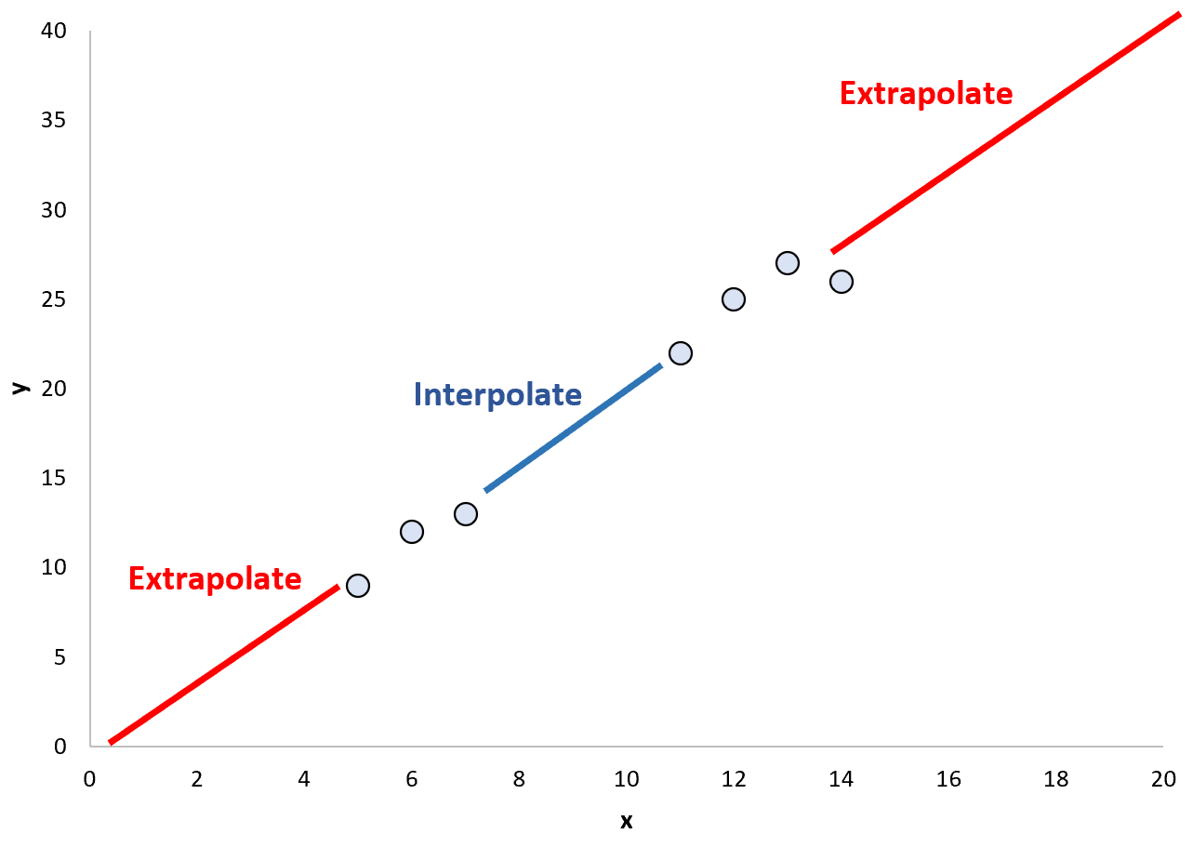
Interpolation and Extrapolation
“Interpolation refers to predicting values that are inside of a range of data points”(2)
“Extrapolation refers to predicting values that are outside of a range of data points.”(2)
Extrapolation is rather important in order to predict future data. But it is still a prediction, and the future could be very different so one has to be careful when using this.

Slide 7
Works Cited
1. https://teahouse.fifty-five.com/en/glossary/data-granularity/
2. https://www.statology.org/interpolation-vs-extrapolation/

